Slide 1

WELCOME

Slide 2
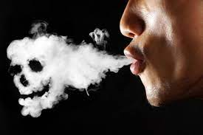
TOBACCO and
YOUNG GENERATION
Dr. S. KATHAR USEAN
ASSISTANT PROFESSOR OF ENGLISH &
COORDINATOR – ENTRPRENEURSHIP DEVELOPMENT CELL
JAMAL MOHAMED COLLEGE, TRICHY.

Slide 3
NOT A HABIT OF RECENT TIMES…
BUT…. AN AGE OLD…….

Slide 4
HABITS CANNOT BE CHANGED EASILY….

Slide 5
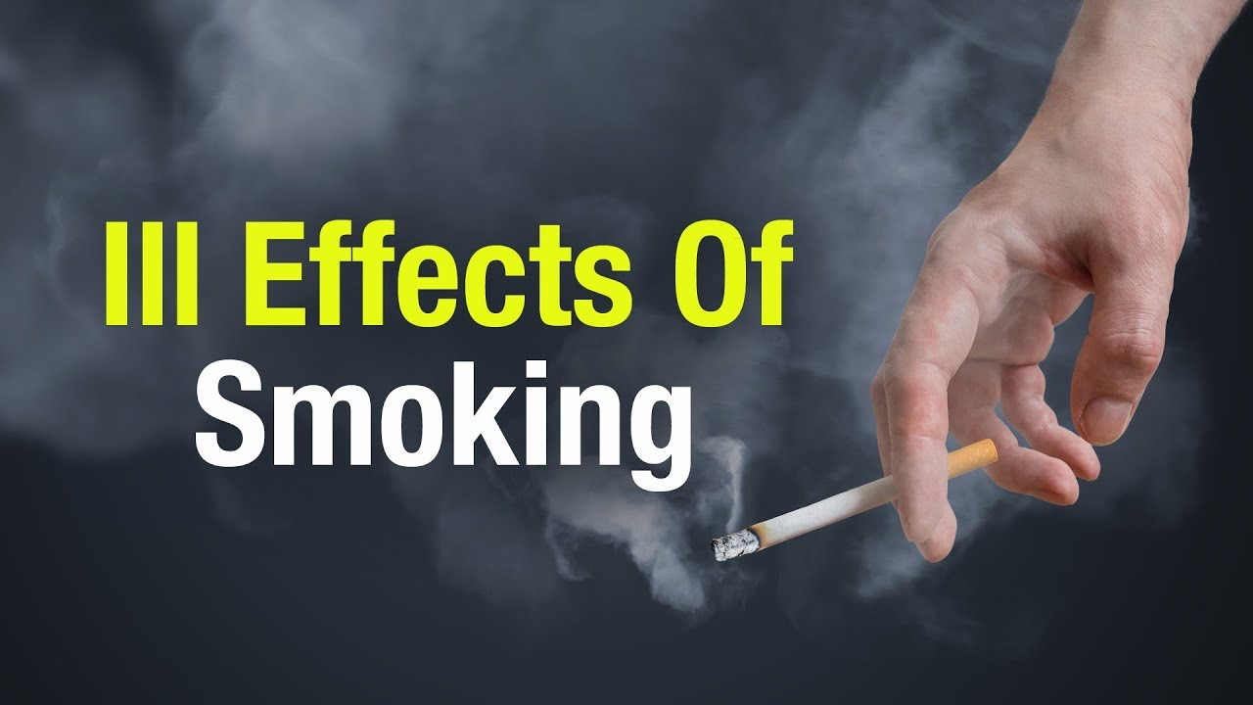

Slide 6
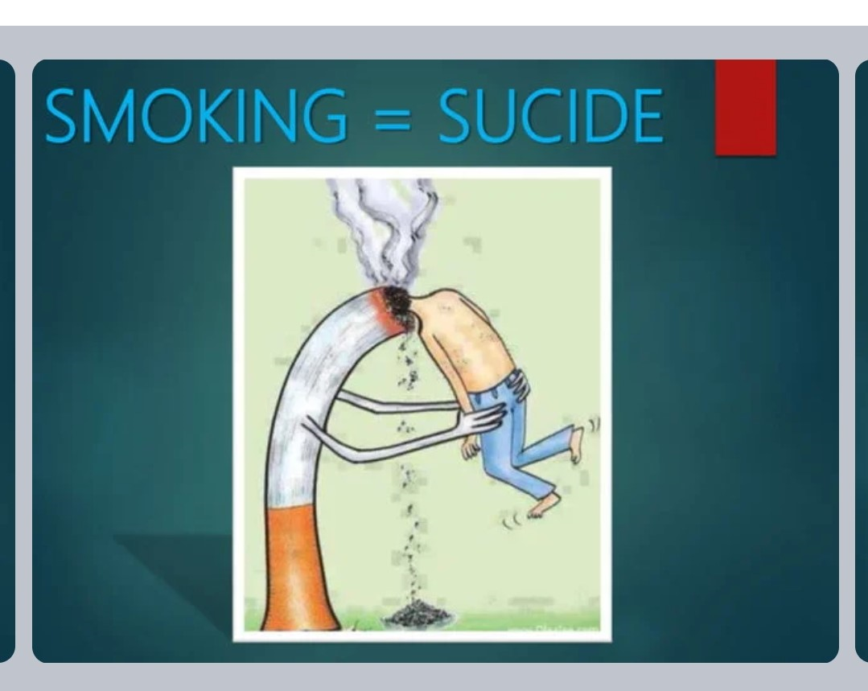
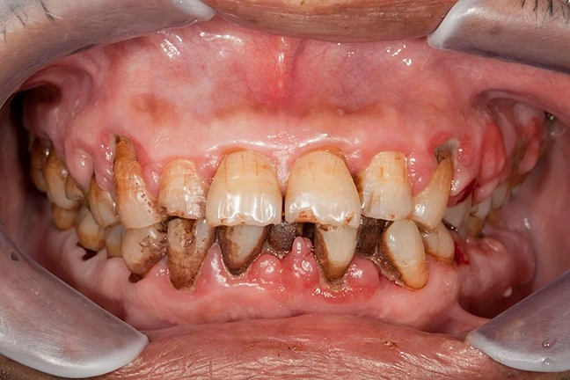
TOBACCO KILLS……

Slide 7

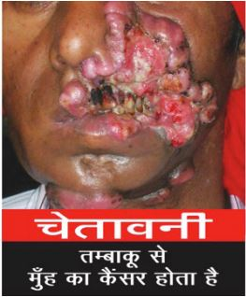
TOBACCO KILLS

Slide 8
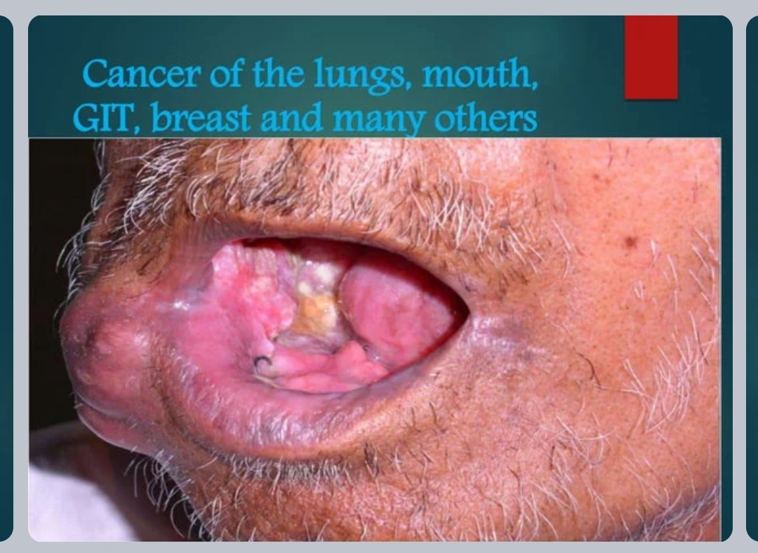
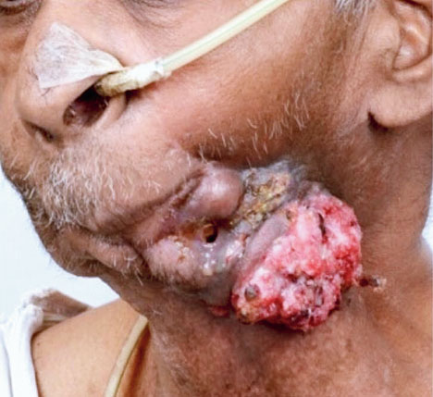
TOBACCO KILLS

Slide 9
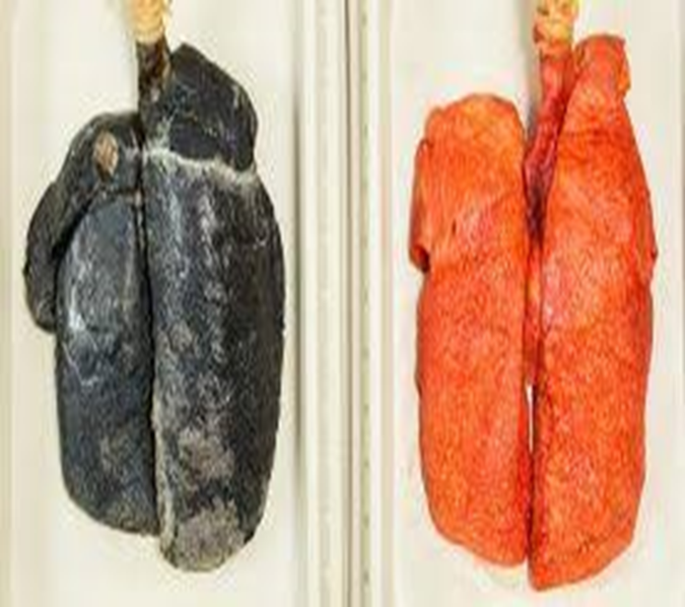
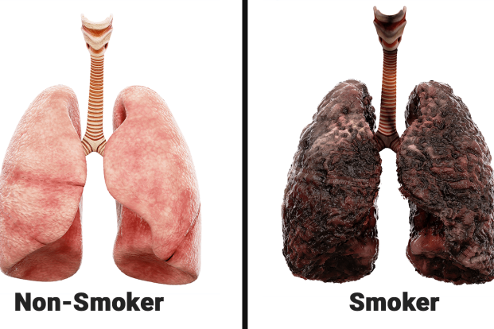

Slide 10
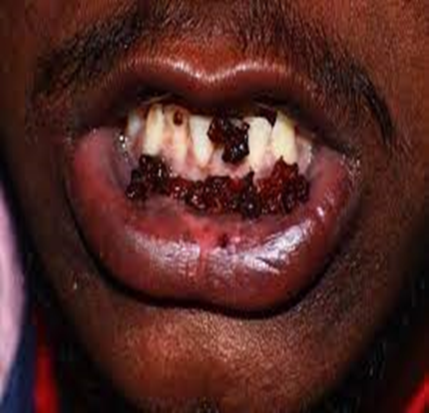
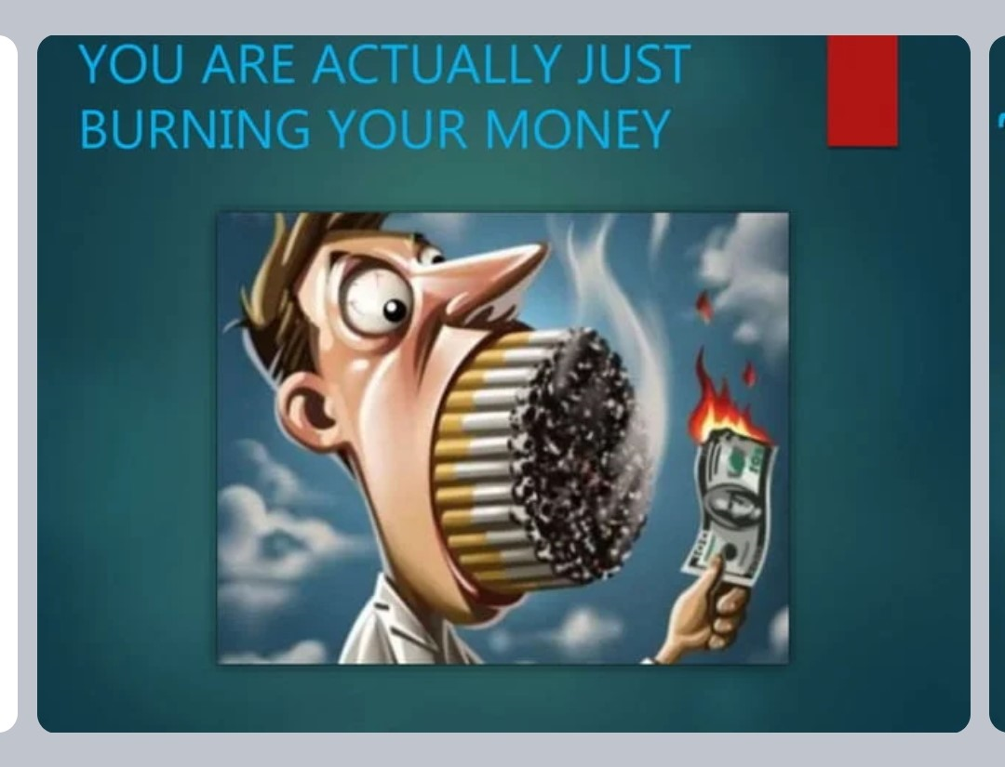
TOBACCO KILLS

Slide 11
Who is at Risk?
# Young People are more likely to addicted.
# Tobacco usage begins during youth and Young adulthood.
# Smoking is popular among the students who live in hostels.

Slide 12
What influences to use Tobacco?
Teens are often influenced by
TV
MOVIES
ACTORS

Slide 13
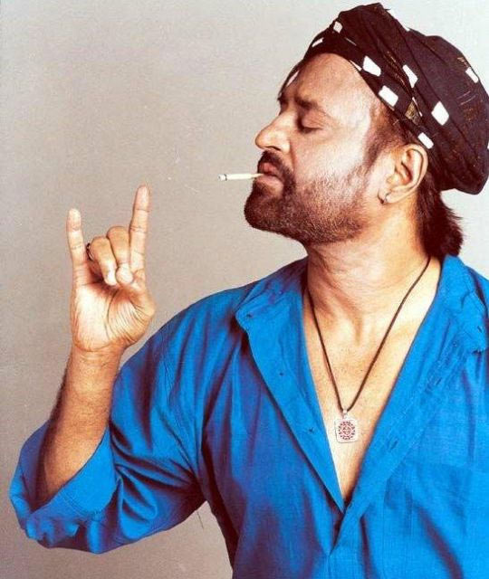
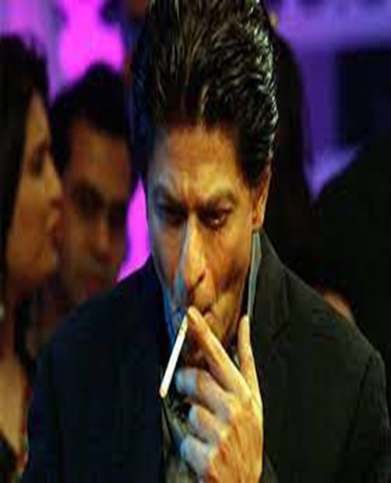

Slide 14
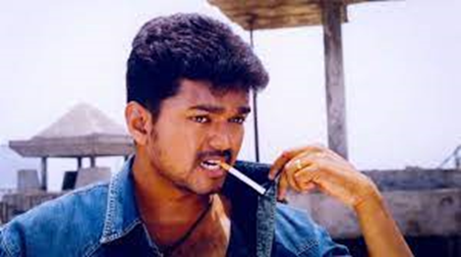
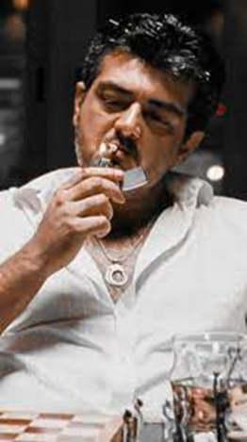

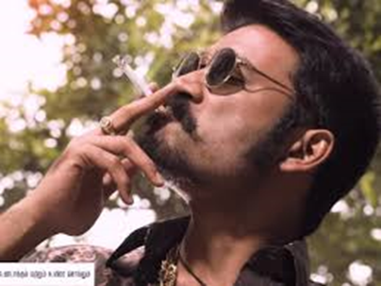

Slide 15
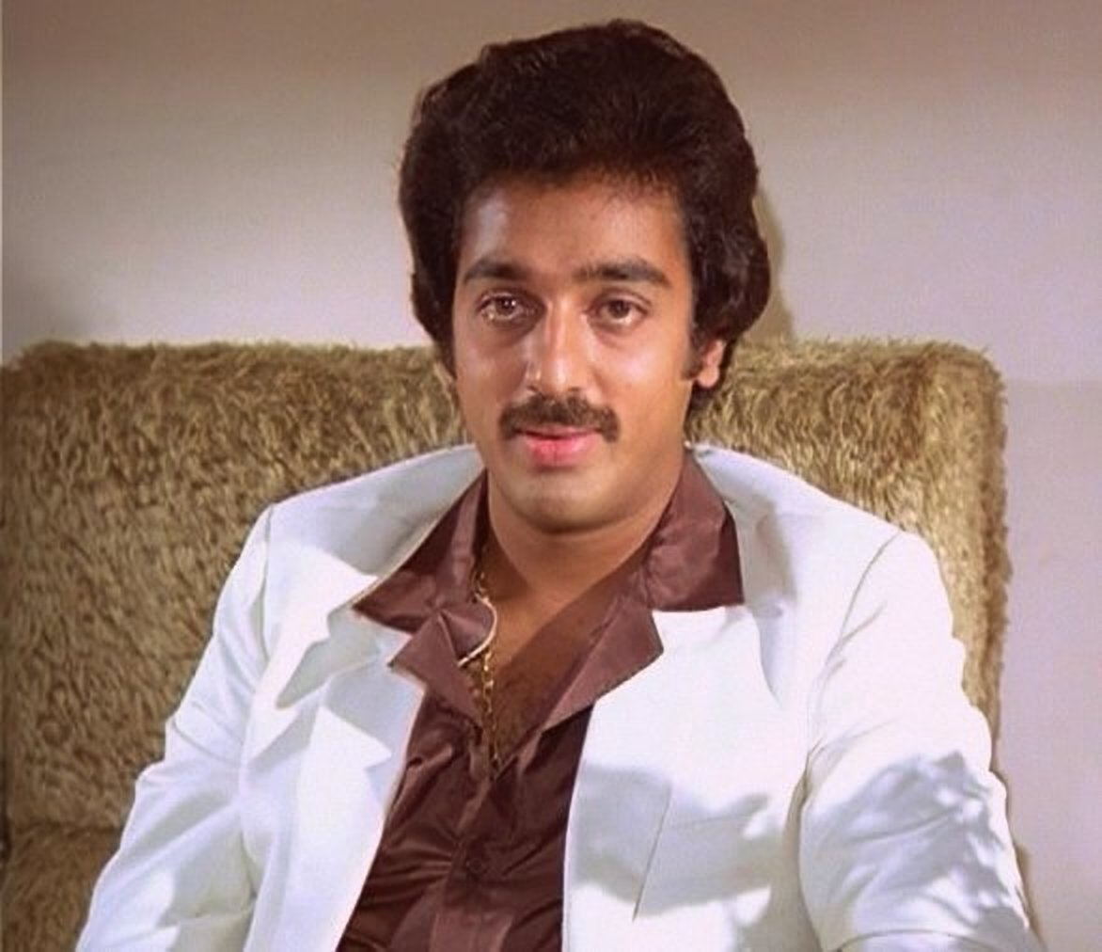
BEFORE…….

Slide 16
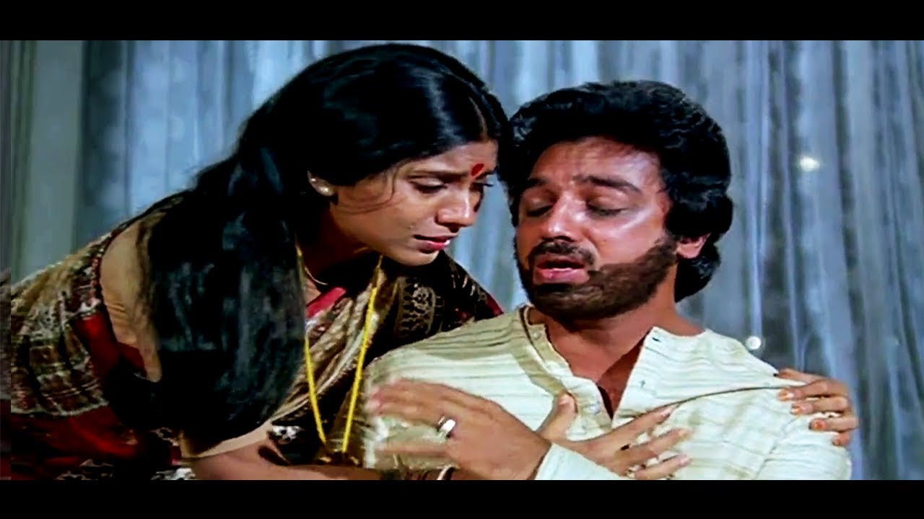
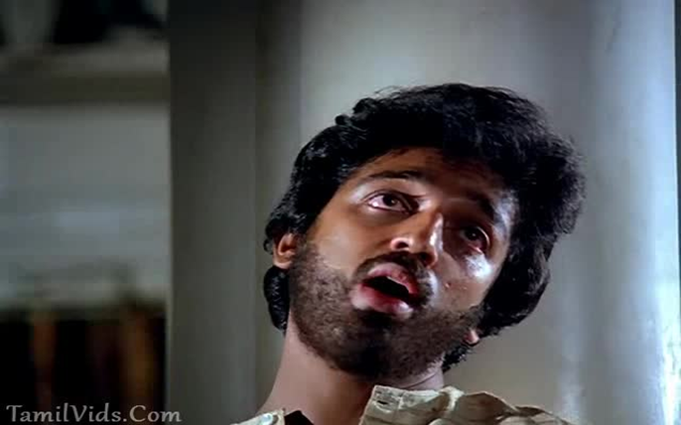
AFTER…..

Slide 17
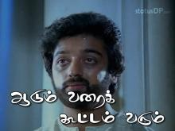

Slide 18

SOCIAL MEDIA

Slide 19
ADVERTISING
&
FRIENDS

Slide 20
Why Do People Smoke Cigarettes?
Parental Influence.
Media Influence.
Genetic Factors.
Stress Factors.

Slide 21
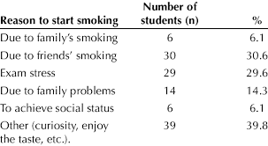

Slide 22
What are the effects of smoking and tobacco?
What happens in your body
Reach your brain, heart and other organs within 10 seconds of your first puff.
Go everywhere your blood flows, harming every part of your body.
also affects how you look and feel, your finances and the people close to you.

Slide 23
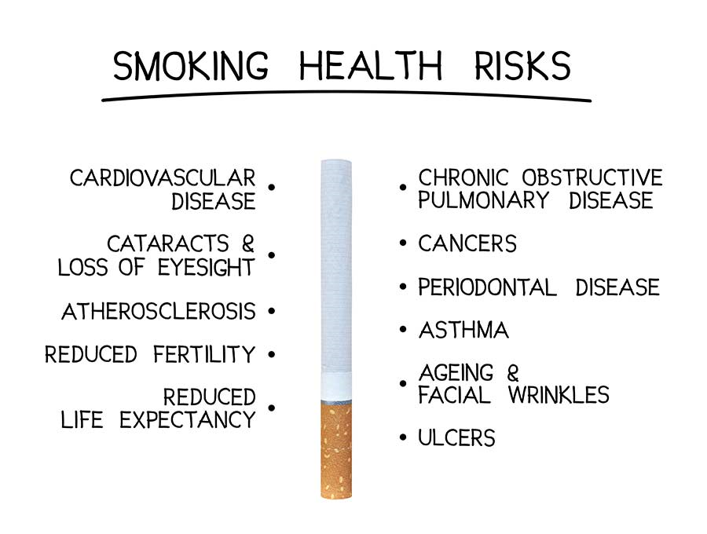

Slide 24
How tobacco affects the way you look
Smoking tobacco can:
- cause yellow-brown stains on your fingers, tongue and teeth.
- increase your risk of tooth loss and bad breath.
- make your skin saggy and give you early wrinkles.
- make your hair lose its natural shine.

Slide 25
How you become addicted
# The nicotine in tobacco is highly addictive.
# It makes your brain release a chemical called dopamine.
# Dopamine is a ‘feel good’ chemical that:
# makes you feel happy.
# helps you to concentrate gives you more energy.
# But this effect doesn’t last long.

Slide 26
Most people who smoke tobacco start during their teenage years or as a young adult.
There are many reasons why a person starts to smoke.
For some teens, it is a way to rebel against their parents.
Other teens may feel pressure from their friends (peer pressure) and begin smoking as a way to appear “cool”.

Slide 27
Nicotine withdrawal symptoms can include any of the following:
Dizziness
(which may last a day or 2 after quitting)
Depression
Feelings of frustration, impatience, and anger
Anxiety
Irritability
Trouble sleeping, including trouble falling asleep and staying asleep, and having bad dreams or even nightmares

Slide 28
Trouble concentrating
Restlessness or boredom
Headaches
Tiredness
Increased appetite
Weight gain
Slower heart rate
Constipation and gas
Cough, dry mouth, sore throat, and nasal drip
Chest tightness
These symptoms can lead a person to start using tobacco again to boost blood levels of nicotine and stop symptoms.

Slide 29

AWARENESS VIDOE

Slide 30
AWARENESS VIDEO

Slide 31


Slide 32


